Slide 1
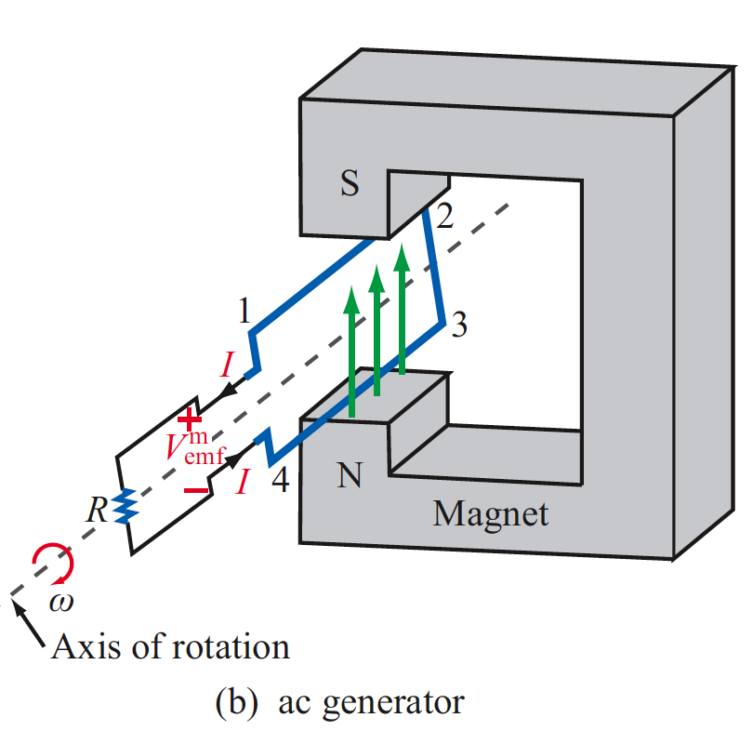
6. Maxwell’s Equations In Time-Varying Fields
Applied EM by Ulaby, Michielssen and Ravaioli

Slide 2
Chapter 6 Overview
Electromotive Force (emf)
Transformer emf
Motional emf
Len’s Law
Motor/Generator
Displacement Current
Charge-Current Continuity Equation
Time-Harmonic EM Potential
Relating E and H for Time-Harmonic Waves

Slide 3
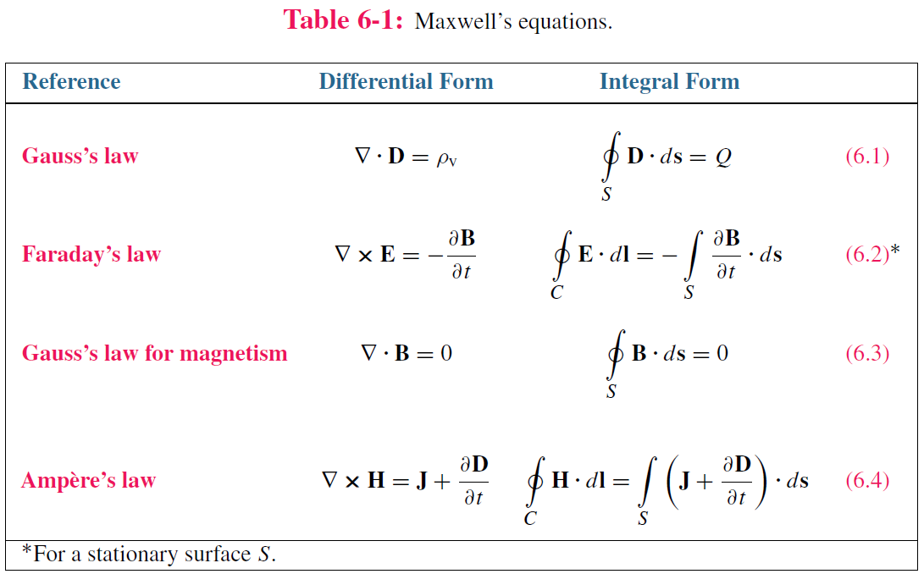
Maxwell’s Equations
In this chapter, we will examine Faraday’s and Ampère’s laws

Slide 4
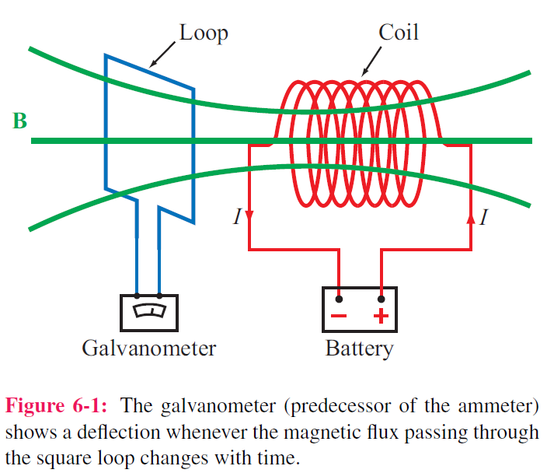
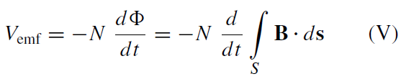
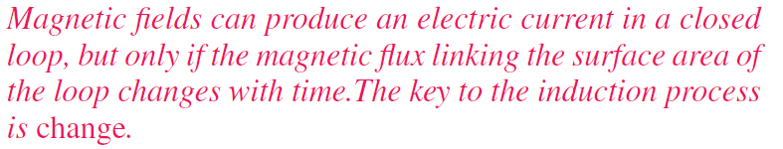
Faraday’s Law
Electromotive force (voltage) induced by time-varying magnetic flux:

Slide 5
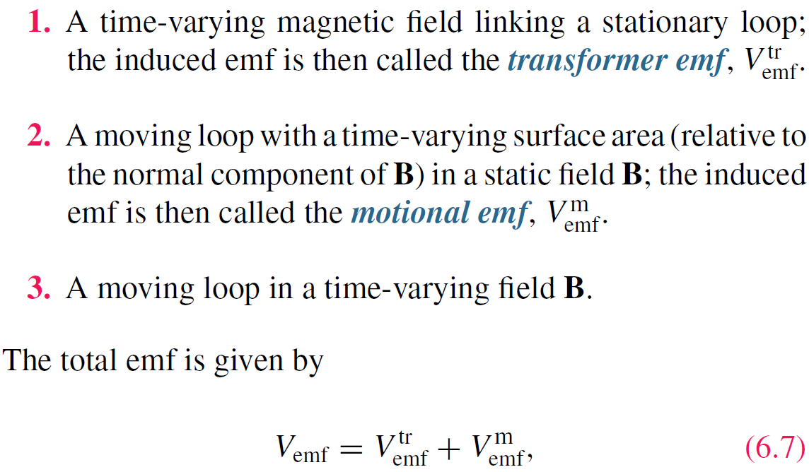
Three types of EMF

Slide 6

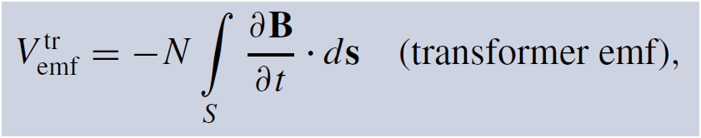
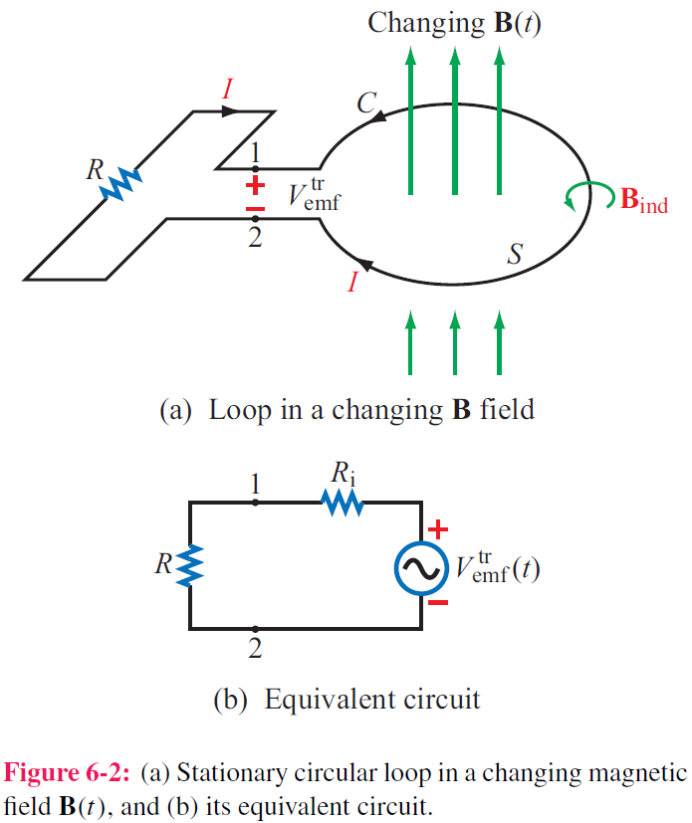
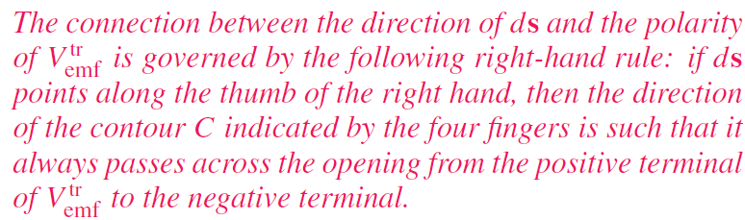
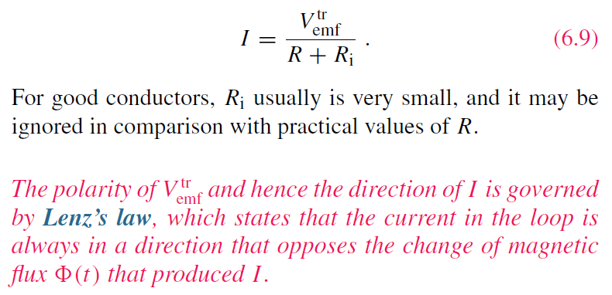
Stationary Loop in Time-Varying B

Slide 7
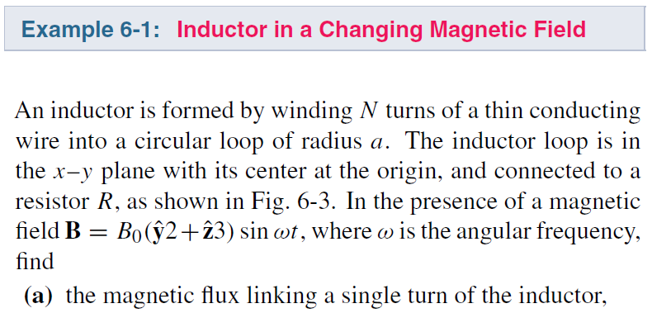
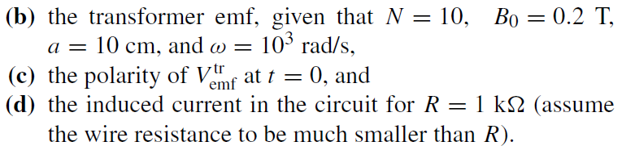
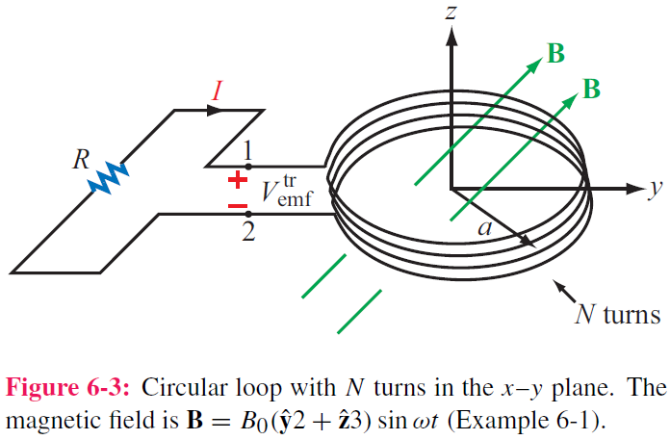
cont.

Slide 8
cont.

Slide 9
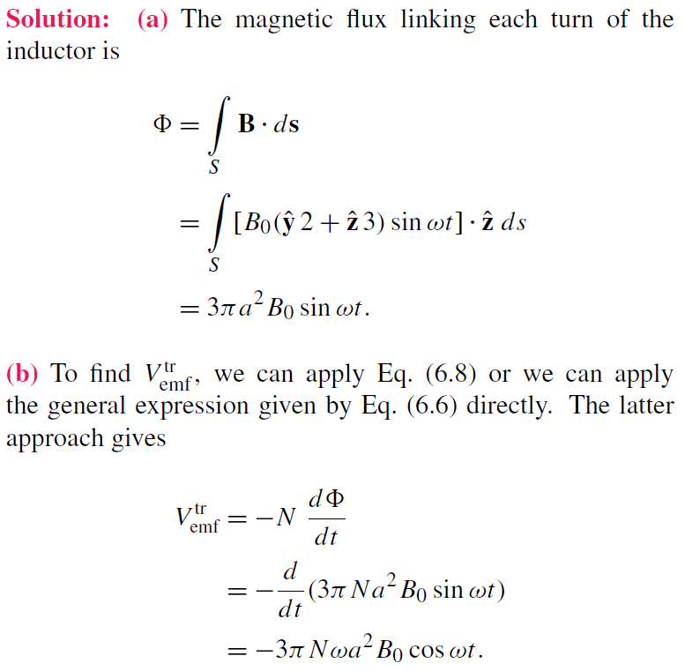
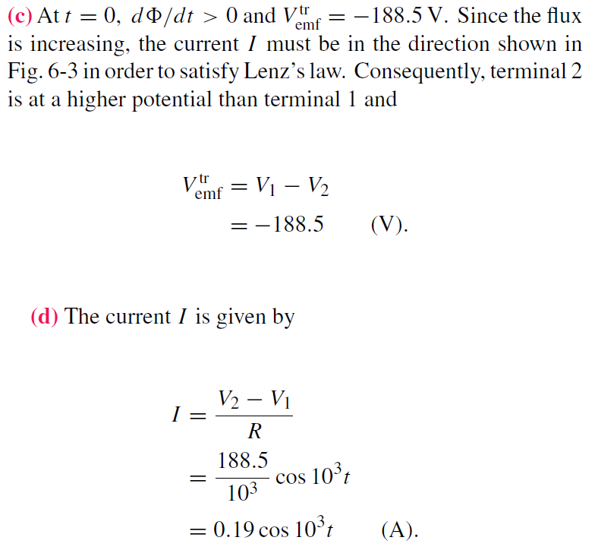
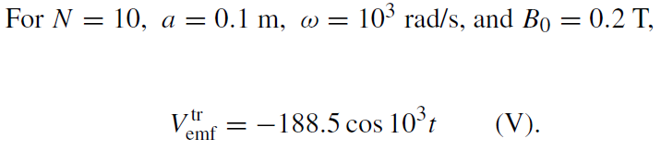
Example 6-1 Solution

Slide 10
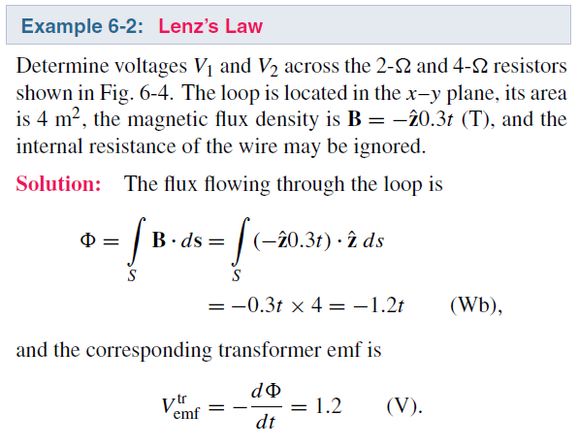
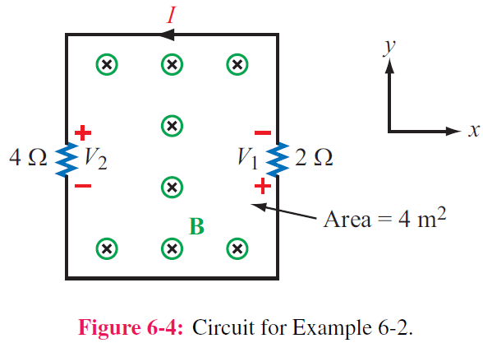

Slide 11
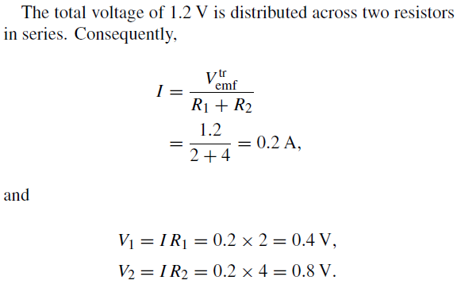

Slide 12
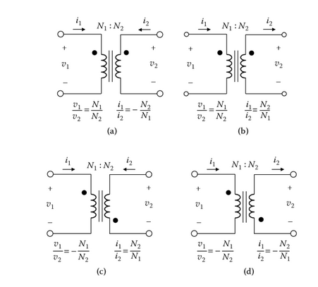
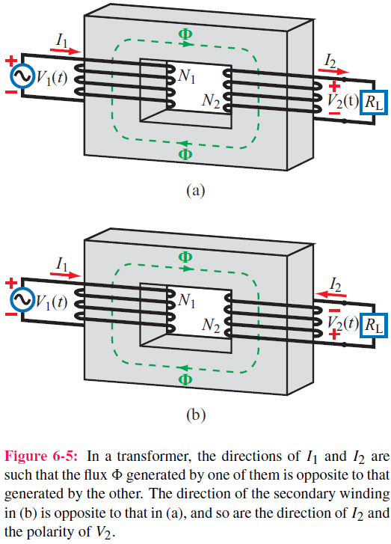
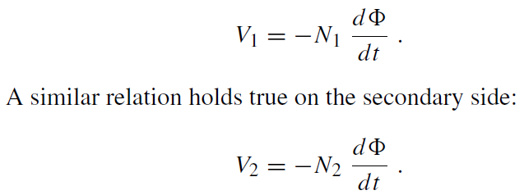
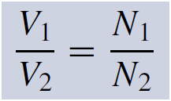
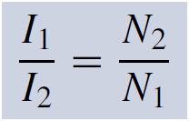
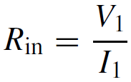
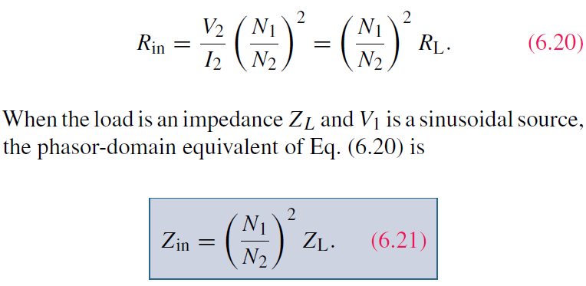
Ideal Transformer

Slide 13
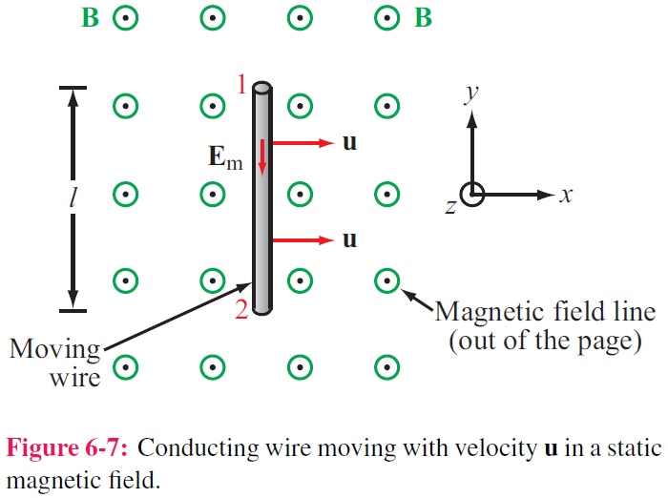

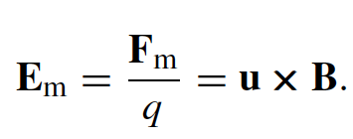
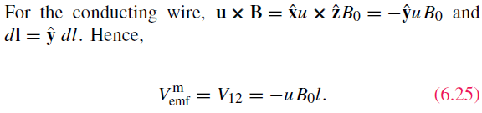
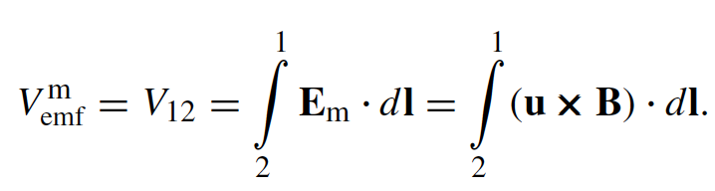
Motional EMF
Magnetic force on charge q moving with velocity u in a magnetic field B:
This magnetic force is equivalent to the electrical force that would be exerted on the particle by the electric field Em given by
This, in turn, induces a voltage difference between ends 1 and 2, with end 2 being at the higher potential. The induced voltage is called a motional emf

Slide 14
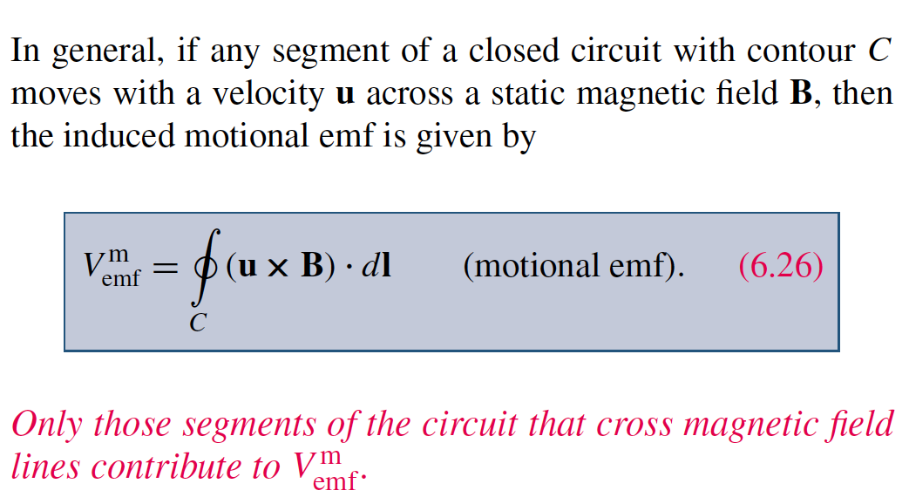
Motional EMF

Slide 15

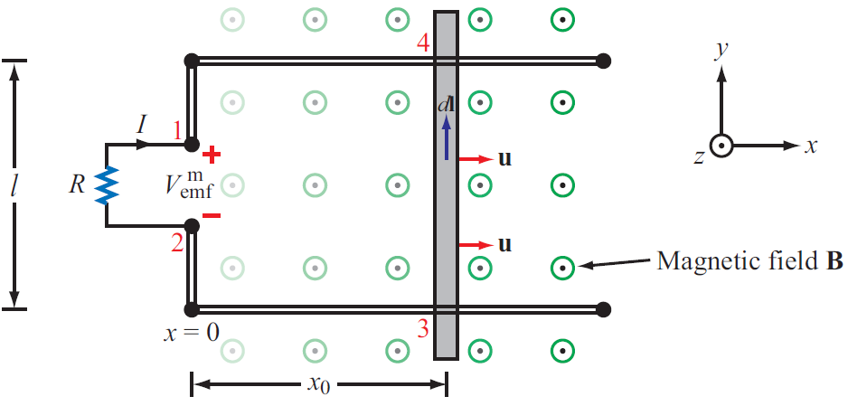
Example 6-3: Sliding Bar
The length of the loop is related to u by x0 = ut
Note that B increases with x

Slide 16
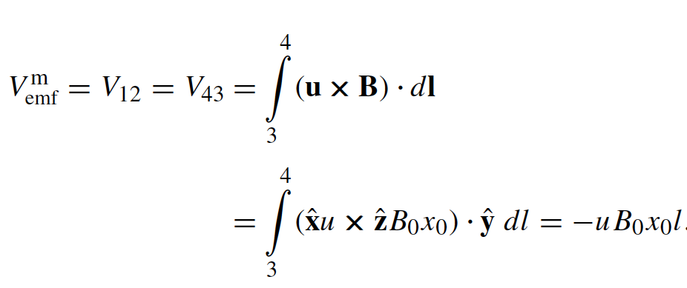
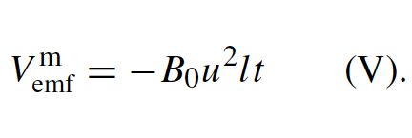
Example 6-3: Sliding Bar
Note that B increases with x
The length of the loop is related to u by x0 = ut. Hence

Slide 17
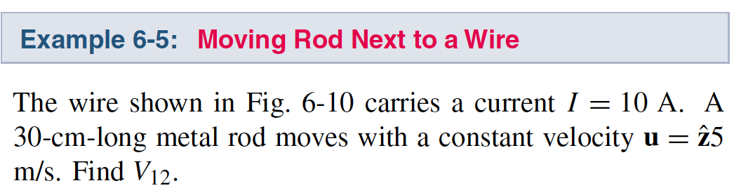
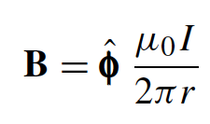
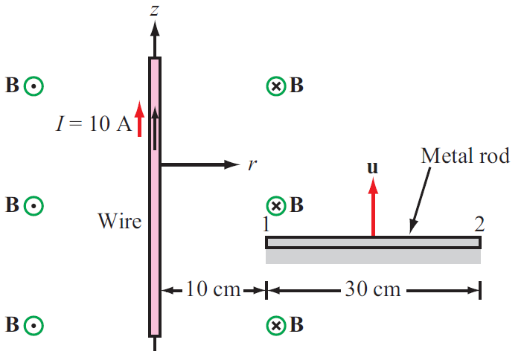

Slide 18
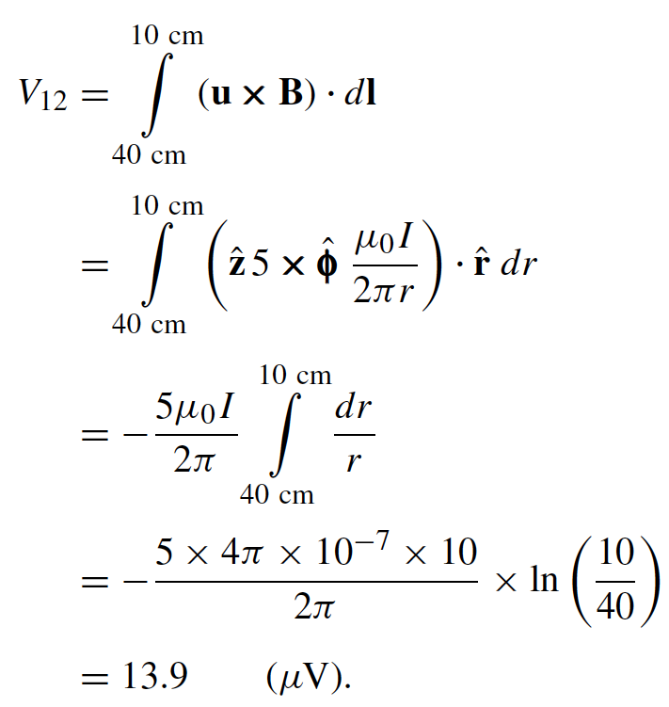

Slide 19
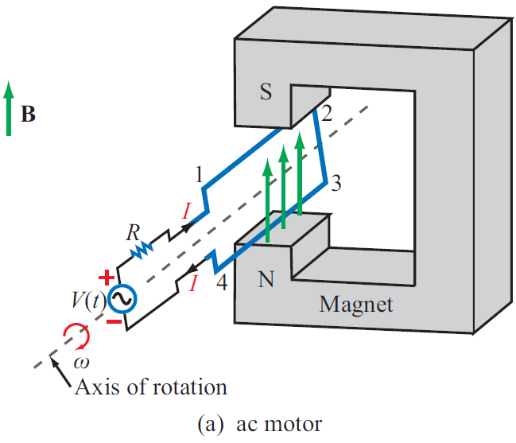
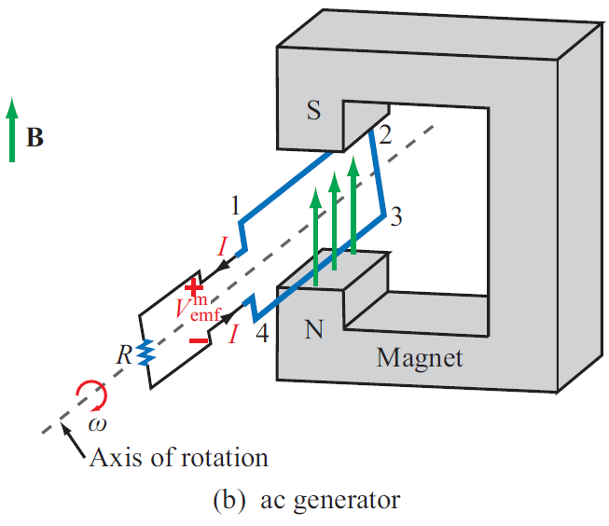
EM Motor/ Generator Reciprocity
Motor: Electrical to mechanical energy conversion
Generator: Mechanical to electrical energy conversion

Slide 20
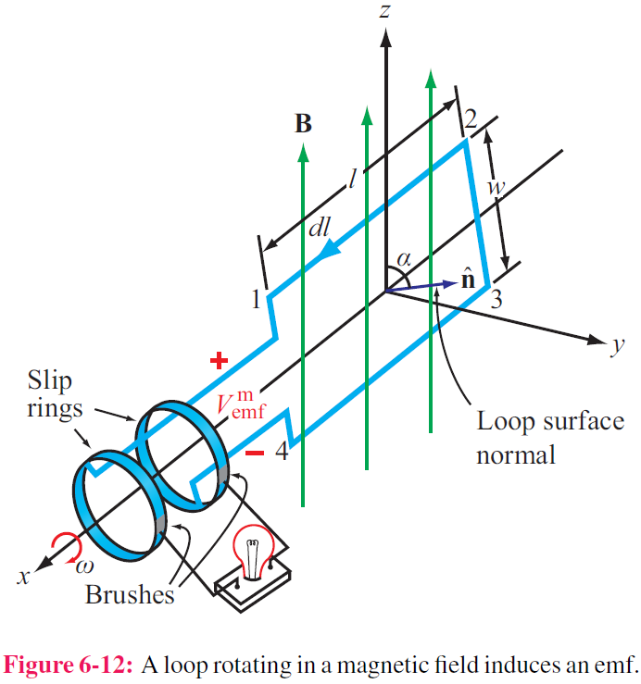
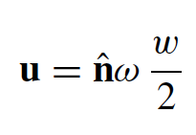

EM Generator EMF
As the loop rotates with an angular velocity ω about its own axis, segment 1–2 moves with velocity u given by
Also:
Segment 3-4 moves with velocity –u. Hence:

Slide 21
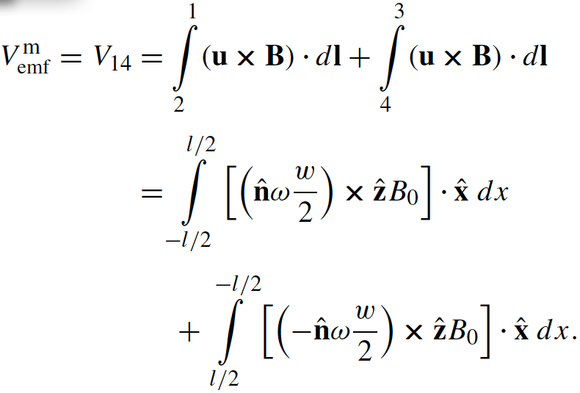


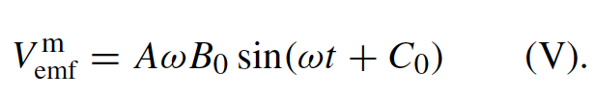
EM Generator EMF
As the loop rotates with an angular velocity ω about its own axis, segment 1–2 moves with velocity u given by
Also:
Segment 3-4 moves with velocity –u. Hence:

Slide 22
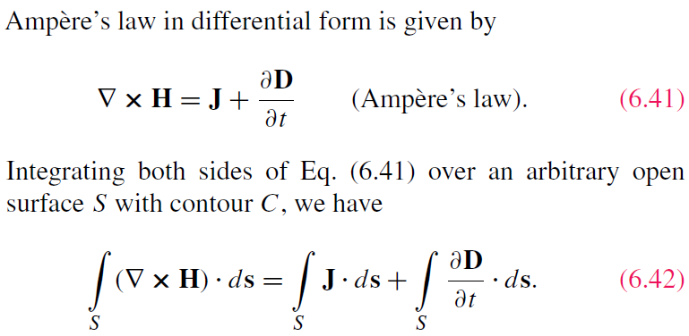
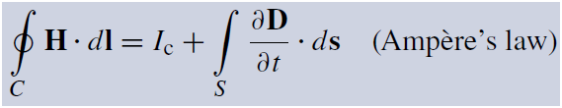
Displacement Current
This term is conduction current I_{C}
This term must represent a current
Application of Stokes’s theorem gives:
Cont.

Slide 23
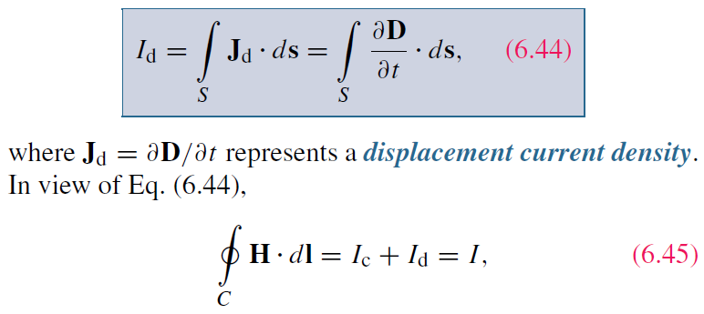

Displacement Current
Define the displacement current as:
The displacement current does not involve real charges;
it is an equivalent current that depends on

Slide 24
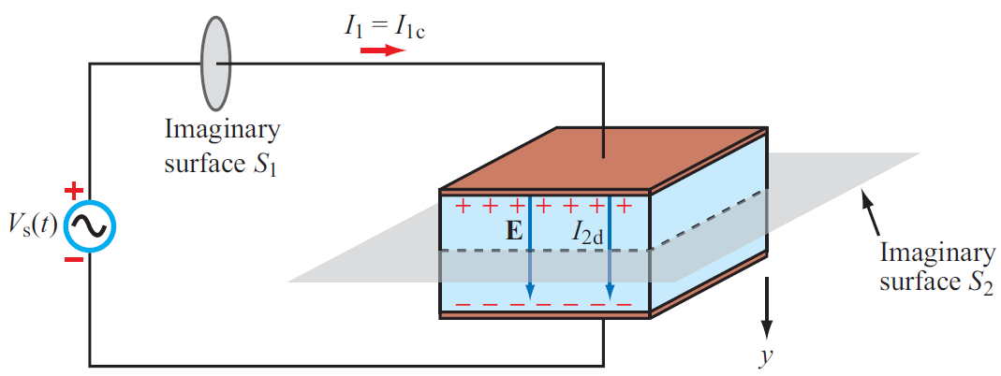
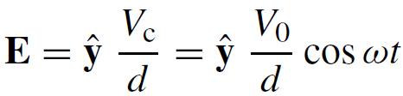
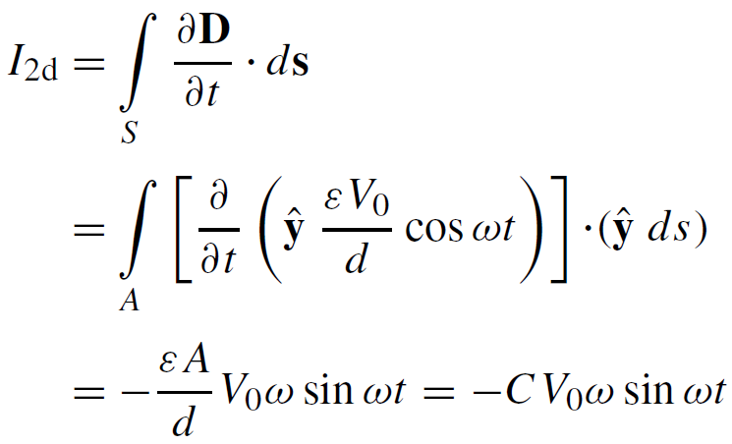


Capacitor Circuit
Given: Wires are perfect conductors and capacitor insulator material is perfect dielectric.
For Surface S₂:
I₂ = I_{2c} + I_{2d}
I_{2c} = 0 (perfect dielectric)
For Surface S₁:
I₁ = I_{1c} + I_{1d}
(D = 0 in perfect conductor)
Conclusion: I₁ = I₂

Slide 25



Slide 26

Boundary Conditions

Slide 27





Charge Current Continuity Equation
Current I out of a volume is equal to rate of decrease of charge Q contained in that volume:
Used Divergence Theorem

Slide 28


Charge Dissipation
Question 1: What happens if you place a certain amount of free charge inside of a material?
Answer: The charge will move to the surface of the material, thereby returning its interior to a neutral state.
Question 2: How fast will this happen?
Answer: It depends on the material; in a good conductor, the charge dissipates in less than a femtosecond, whereas in a good dielectric, the process may take several hours.
Derivation of charge density equation:
Cont.

Slide 29




Solution of Charge Dissipation Equation
For copper:
For mica:
= 15 hours

Slide 30





EM Potentials
Static condition
Dynamic condition
Dynamic condition with propagation delay:
Similarly, for the magnetic vector potential:

Slide 31










Time Harmonic Potentials
If charges and currents vary sinusoidally with time:
Also:
we can use phasor notation:
with
Maxwell’s equations become:
Expressions for potentials become:

Slide 32

Cont.

Slide 33

Cont.

Slide 34

Example 6-8 cont.
Cont.

Slide 35

Example 6-8 cont.

Slide 36
Formulas in Time-Varying EM Fields

